Slide 1

University Data Analysis
Power-BI
By
Neelanjan Chakraborty

Slide 2
Contents
Business Objective – Problem Statement
Solution Methodology
Data Preparation and Consolidation
Key Challenges
Result
Conclusion

Slide 3
Business Objective – Problem Statement
Offering too much information
Displaying unclear metrics
Problem Statements
To find or analyze the insights details within an Collateral Education data.
To transform and clean the data into a data model and create charts or graphs to provide visuals of the data.
Objectives

Slide 4
Solution Methodology
Solution Methodology
Technology Enablers
Realized Objectives
Plan
POWERBI
To find or analyze the insights details within an Collateral Education data.
To transform and clean the data into a data model and create charts or graphs to provide visuals of the data.
Requirements gathering and prototype
Design
Build and validate

Slide 5
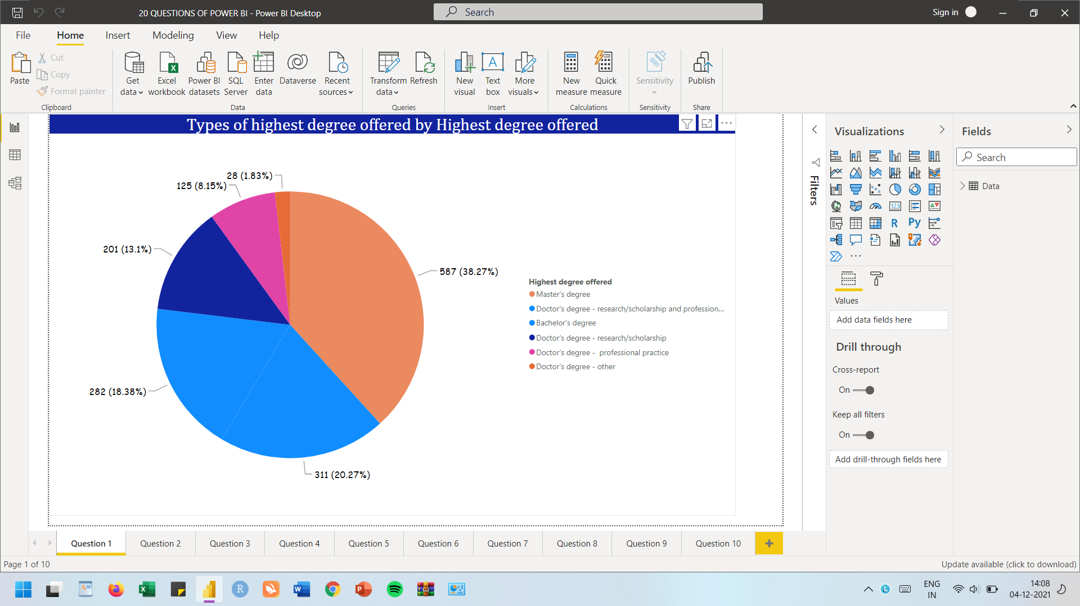
Data Preparation and Consolidation

Slide 6
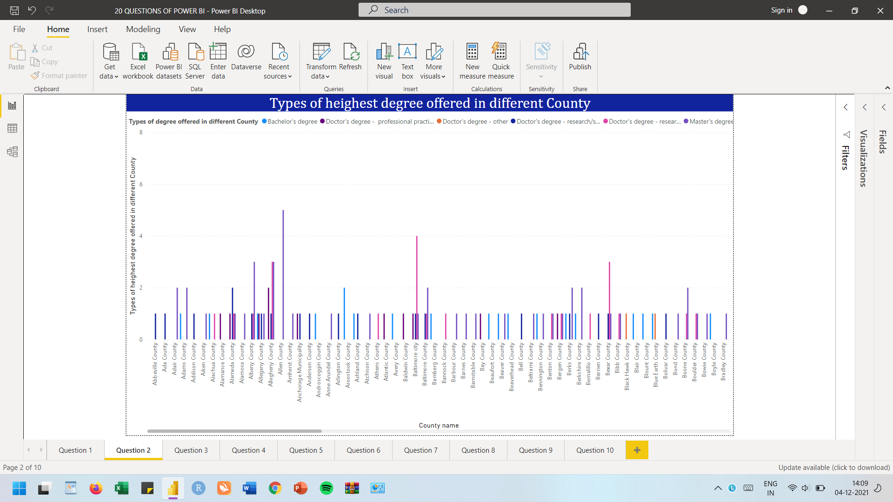
Data Preparation and Consolidation

Slide 7
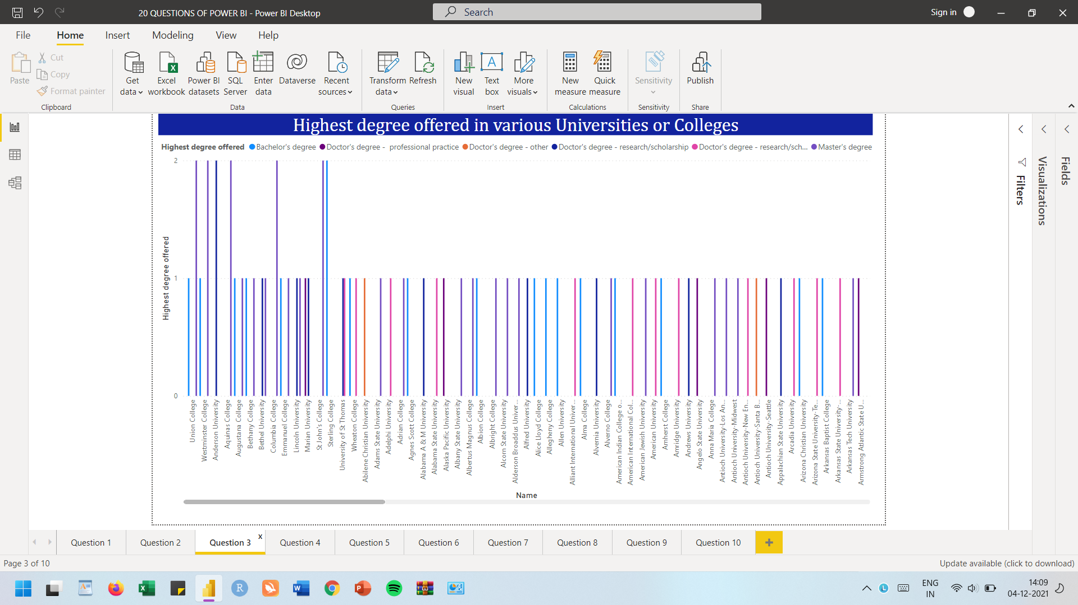
Data Preparation and Consolidation

Slide 8
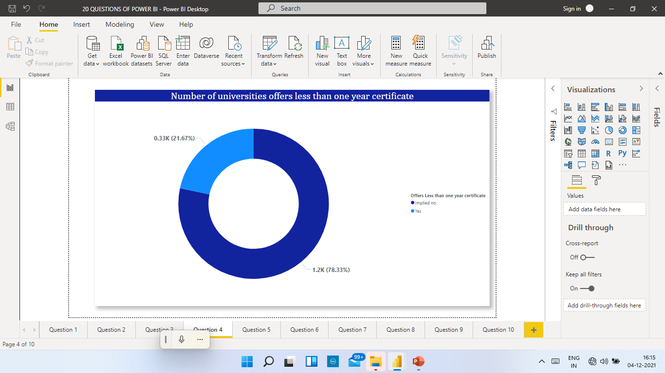
Data Preparation and Consolidation

Slide 9
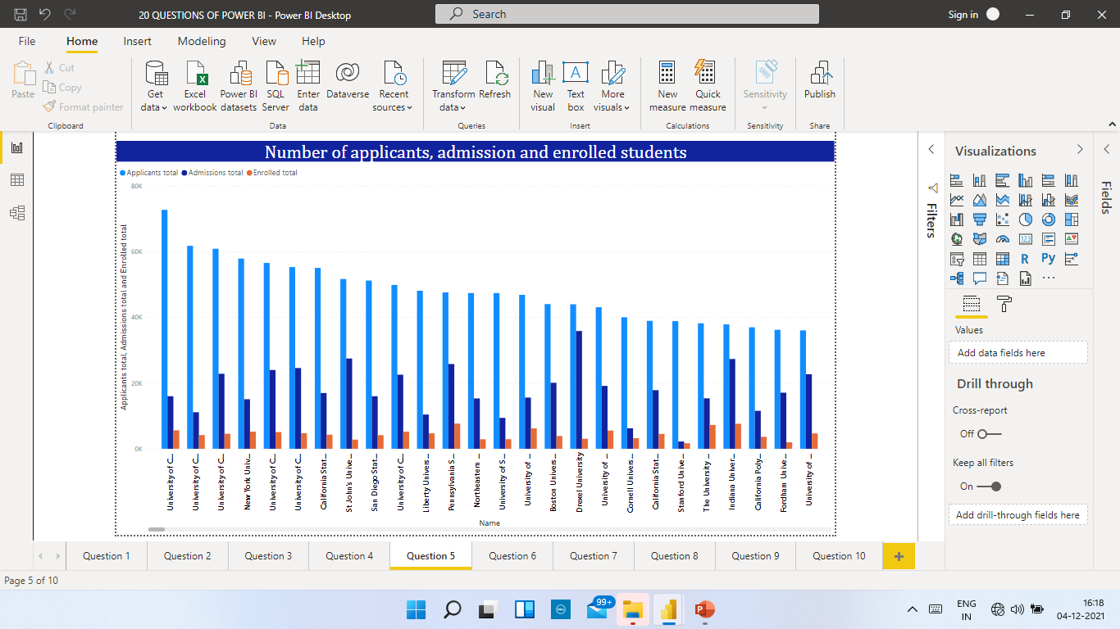
Data Preparation and Consolidation

Slide 10
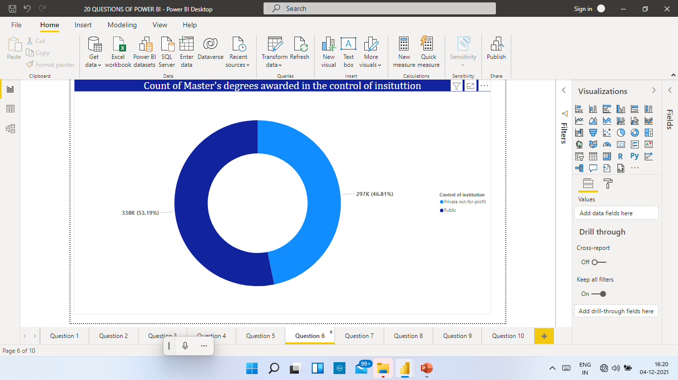
Data Preparation and Consolidation

Slide 11
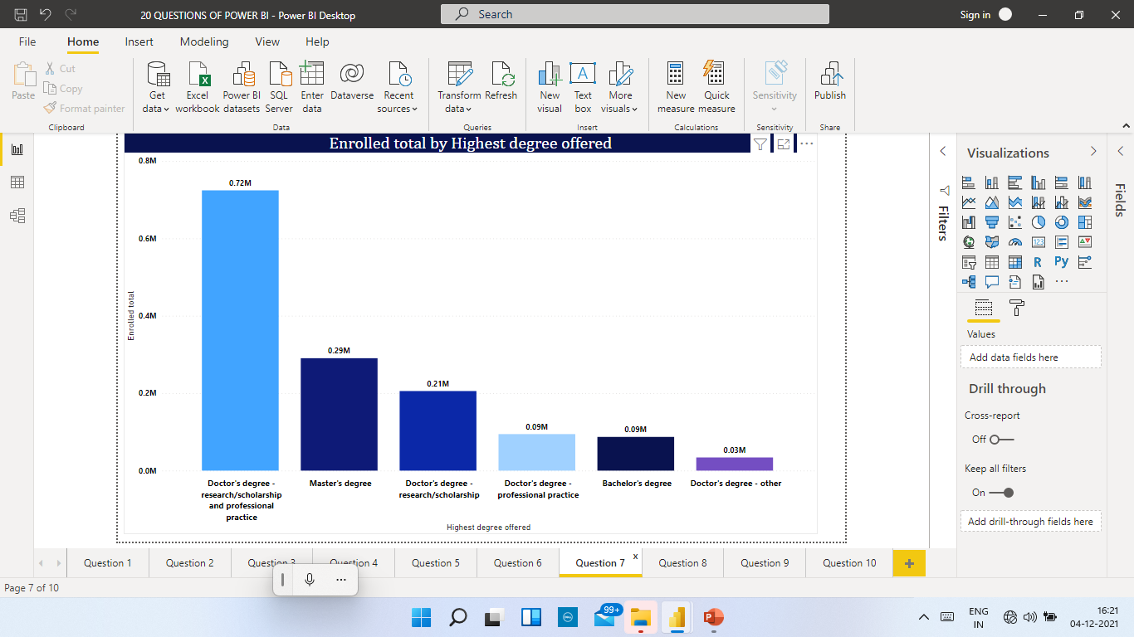
Data Preparation and Consolidation

Slide 12
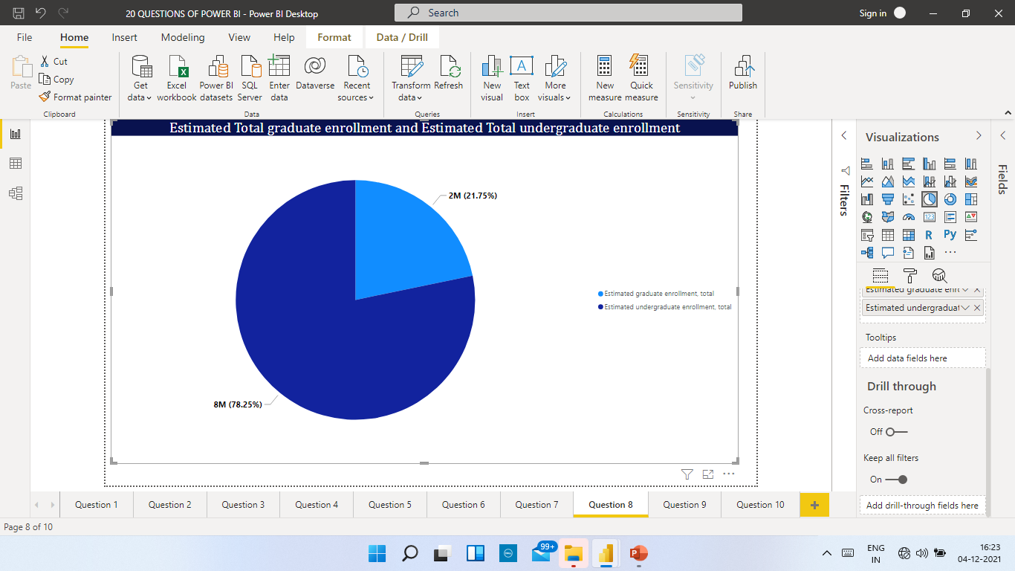
Data Preparation and Consolidation

Slide 13
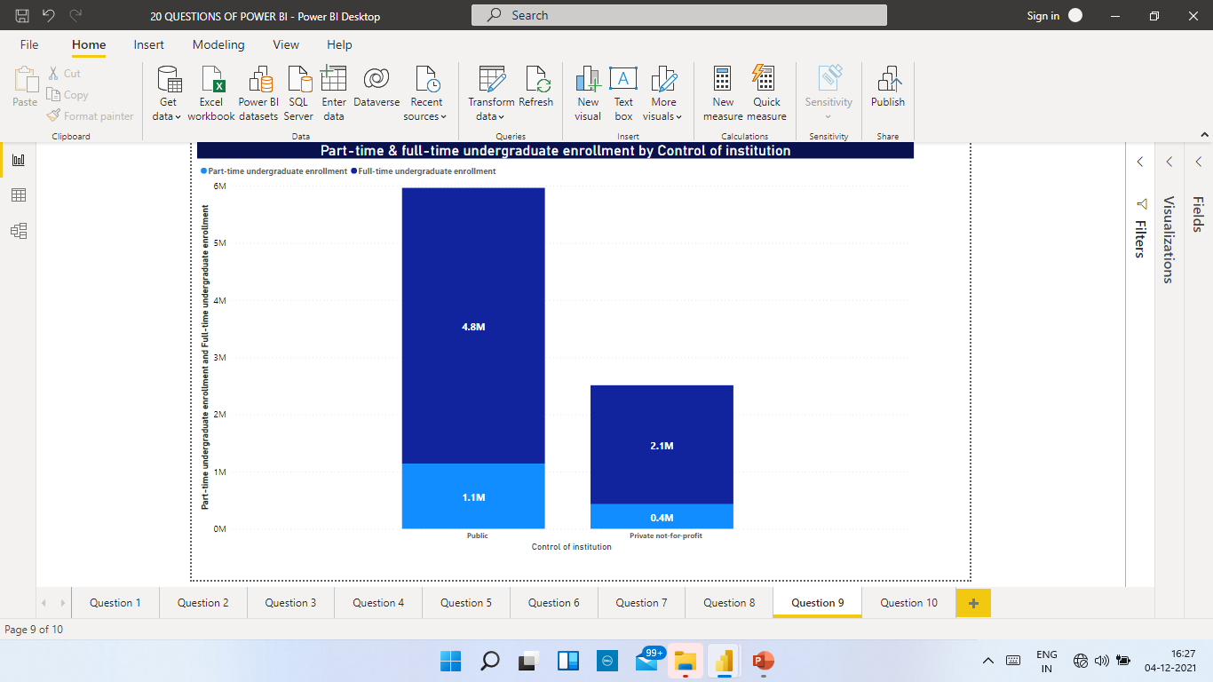
Data Preparation and Consolidation

Slide 14
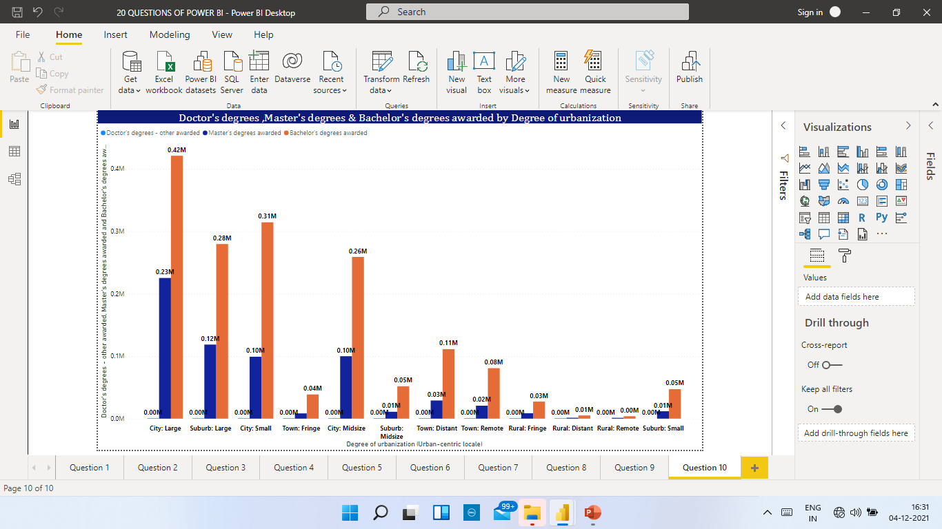
Data Preparation and Consolidation

Slide 15
Key Challenges
Integrating data from different source systems
Creating a data-driven culture
Managing the use of self-service BI tools
Bad data visualization and dashboard design practices
Analyzing data from different data section

Slide 16
Project Plan and Support Required
Results
Conclusion
Firstly, with this dashboard, we can track the University enrollment details by noting the total number of students. along with degree details. Also, we can see how many college and university members have been their in public and private in the control of institution.
The “University Degree ” doughnut chart displays the number of university who are providing masters graduation degree and who are their in private and public university
This data can help the university ensure they are able to meet students’ career in future as per their needs.
Overall, Power BI Dashboard helps to better visualize their data in order to gain actionable insights from their Organization.
To make the best use of these dashboards, organizations need relevant data, and there lies a big challenge.
By using the “Select Year” and “Select college ” drop-down list box filters, viewers can customize the dashboard to display data for any combination of years.
These filters can be applied to any dashboards that display data across time periods or for separate, defined groups. As can be seen, this can be especially useful for reviewing trends over time.
Even though Power BI supports most of the common databases, it does not handle cloud-based data sources outside the Microsoft ecosystem well.

Slide 17

Thank You

